Slide 1
BANKING PROJECT
BASED ON PANDAS,MATPLOTLIB AND SEABORN
By – Priyanshu

Slide 2
📖 Data Story (Introduction & Objective)
In today’s competitive banking environment, retaining customers is just as crucial as acquiring them. Using a real-world dataset of over 10,000 bank customers, this project explores key factors influencing customer churn—that is, when a customer decides to leave the bank.
With the help of Python libraries like pandas, matplotlib, and seaborn, we performed exploratory data analysis to identify patterns, trends, and potential red flags in customer behavior. Our focus was to uncover which demographics, account features, and behavioral attributes most affect churn likelihood.
This data-driven story aims to:
Visualize churn distribution across various customer segments.
Highlight the impact of factors like tenure, credit score, balance, and geography.
Provide actionable insights to improve customer retention strategies.

Slide 3
Understanding the Bank Churn Dataset
This project starts with importing a customer dataset from a CSV file using Python. The main goal is to analyze the data and understand the reasons why customers are leaving the bank (also called "churn").
In this screenshot, we’ve:
Imported key Python libraries like pandas, numpy, matplotlib, and seaborn. These help with data handling and visualization.
Loaded the dataset using pd.read_csv() from a local file path.
The dataset contains 10,000 rows and 13 columns. Each row represents a customer’s information.

Slide 4

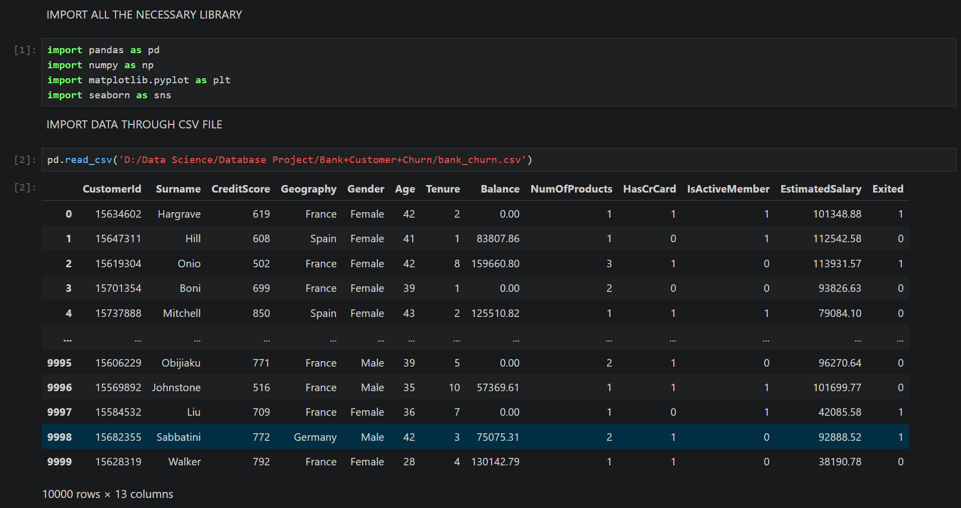
FINANCE DATA
HERE I BROUGHT DATA THROUGH CSV

Slide 5
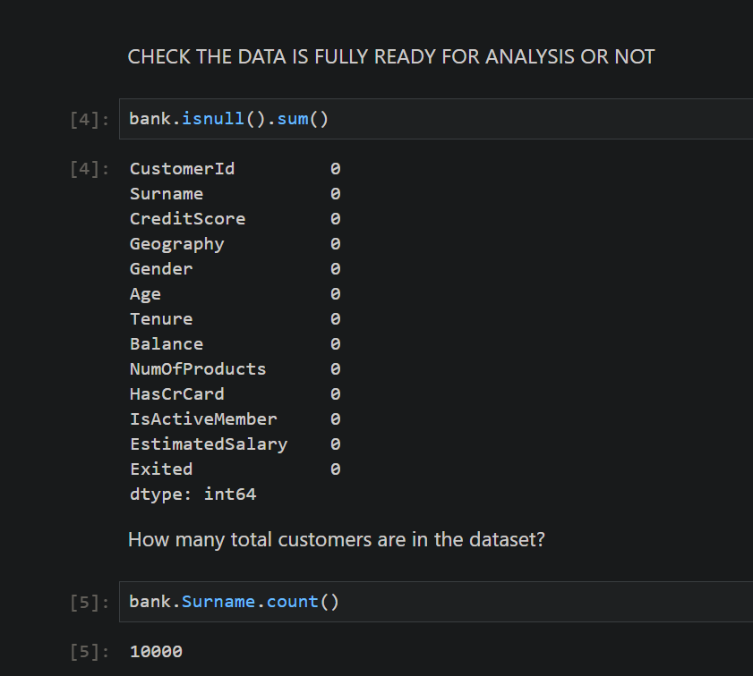
Data Quality Check – Is Our Dataset Ready?
Before starting any analysis, it’s important to check if the dataset is complete and clean.
This slide shows the data validation step. We used the line:
bank.isnull().sum()
This checks each column for missing values.
The result? Zero missing values across all 13 columns. That means:
Every customer has a credit score, age, gender, and other required details.
No data cleaning is needed at this stage.
Next, we used:

Slide 6
Understanding Customer Age Distribution
This histogram shows how customer ages are distributed in our dataset.
The most common age group is between 30 and 40 years, with a clear peak around 35, where we see the highest number of customers. As the age increases beyond 40, the number of customers steadily decreases.
We also added a smooth curve (KDE plot) to visualize the general shape of the distribution. This highlights that our customer base is skewed slightly to the right — meaning we have more younger customers than older ones.
Understanding this helps us target marketing and services toward the most active age group while also recognizing where we may need to improve engagement with older demographics.

Slide 7
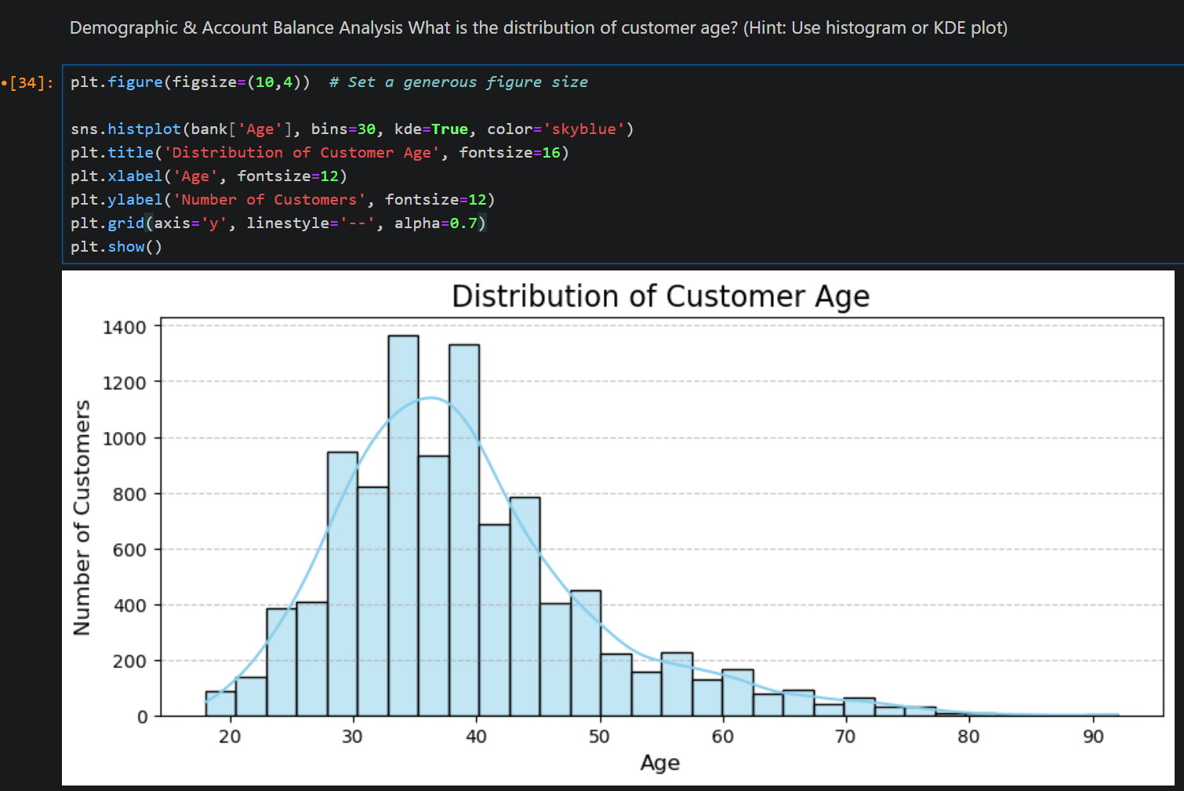

Slide 8
How Customer Balance Varies with Age
This scatter plot shows the relationship between customer age and their account balance, while also indicating churn status.
Most customers, regardless of age, have balances spread between 50,000 to 200,000. There's no strong correlation between age and balance—customers of all ages hold similar balance ranges.
However, notice the color pattern:
Blue dots-represent customers who stayed
Red dots-represent customers who churned
We can see that churned customers (red) are more common in the older age group (above 50), especially those with higher balances. This might suggest that older customers with high balances are more likely to leave—something worth looking into further.
This insight can help target retention strategies more effectively by focusing on high-balance, older customers.

Slide 9
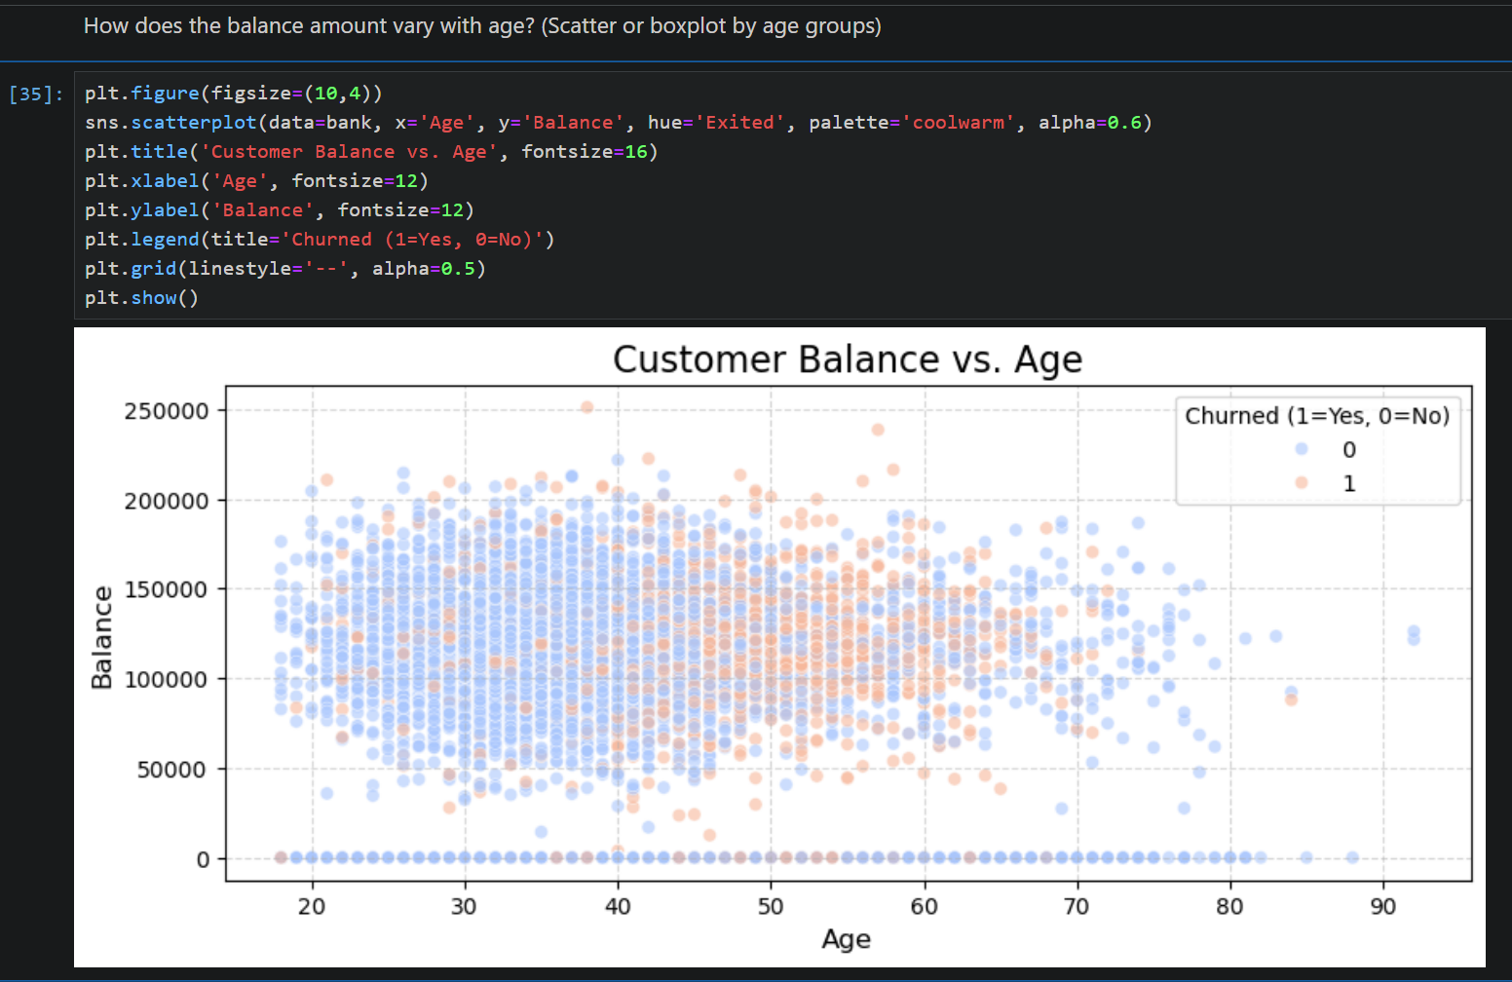

Slide 10
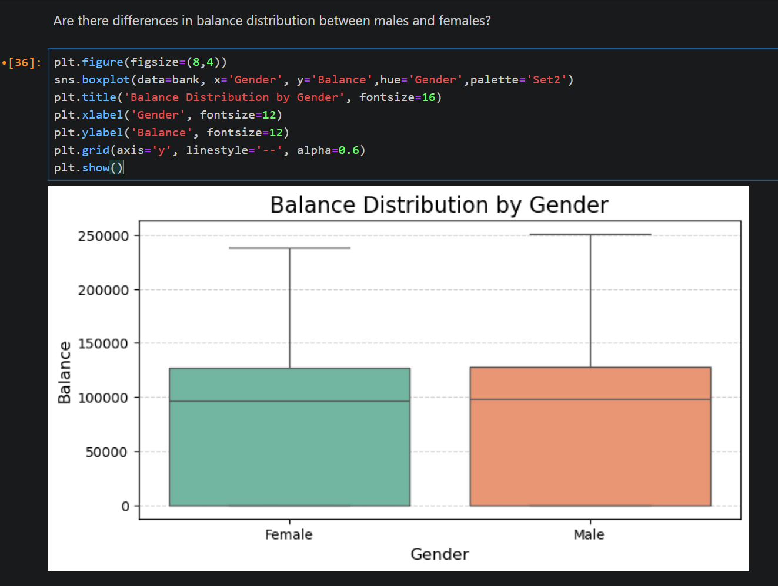
Balance Distribution by Gender
This boxplot compares how account balances are distributed between male and female customers.
At a glance, both groups have a very similar distribution:
The median balance is almost the same for both.
The overall range and spread of balances is also quite comparable.
Both genders have some high-balance outliers, but there’s no strong indication that one gender consistently holds more money than the other.

Slide 11
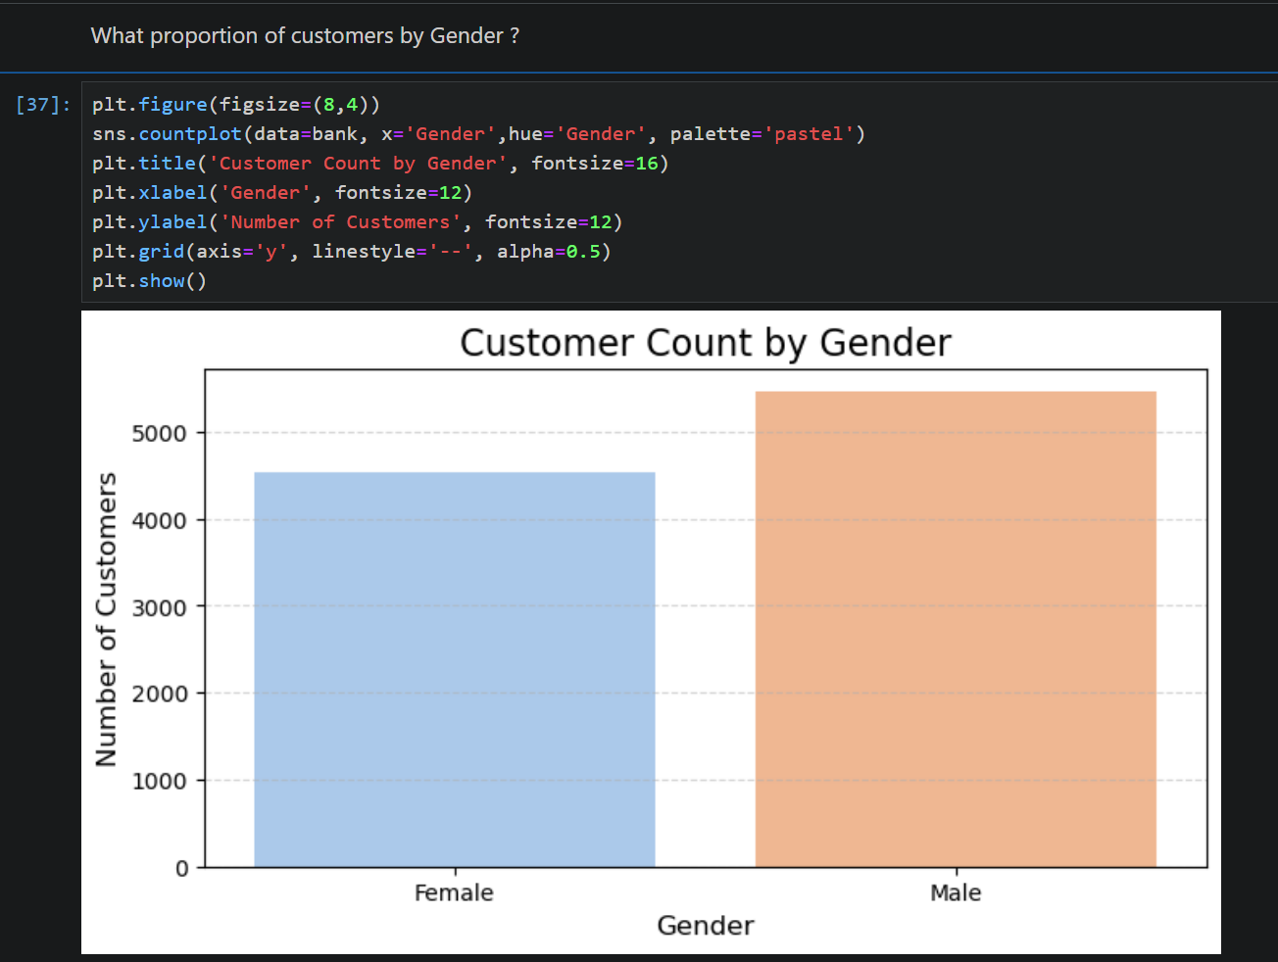
Customer Count by Gender
This bar chart shows the number of customers by gender.
We can see that male customers slightly outnumber female customers in this dataset.
Around 5,500 male customers
Around 4,500 female customers
The difference isn’t huge, but it's clear that the customer base leans more toward males.

Slide 12
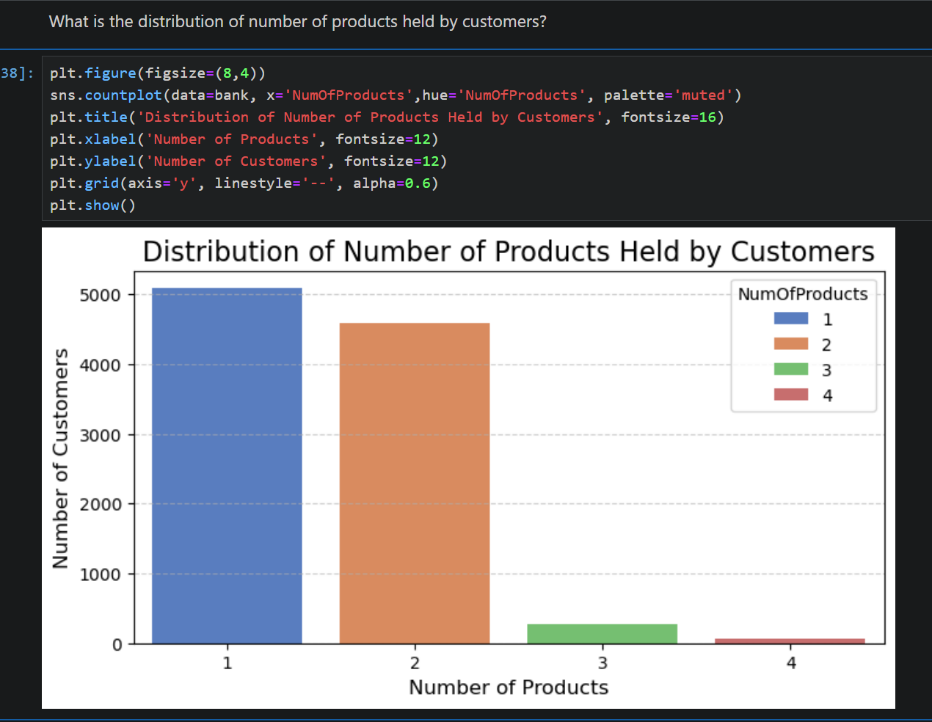
Number of Products Held by Customers
Description :
This chart shows how many products each customer holds.
Most customers use either 1 or 2 products, with:
Over 5,000 customers having just 1 product
Around 4,500 customers using 2 products
Very few customers hold 3 or more products, and the number drops sharply after that.
3-product holders are rare
4-product holders are almost nonexistent

Slide 13
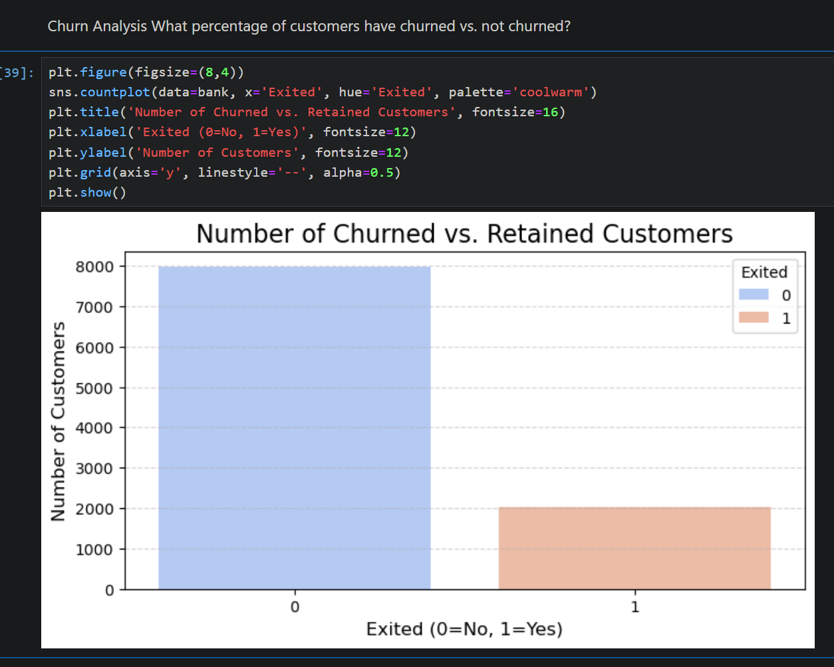
Churn vs. Retained Customers
This chart compares the number of customers who churned (left the company) with those who stayed.
The difference is clear:
Around 8,000 customers are still active (Exited = 0, blue)
Around 2,000 customers have churned (Exited = 1, red)
That means roughly 1 in 5 customers have left. This gives us a churn rate of about 20%, which is a strong signal to look deeper into why those customers exited.

Slide 14
Churn Rate by Active Credit Card Status
This bar chart answers a key question — does having an active credit card reduce the chance of churn?
The answer is yes.
Customers without an active credit card (IsActiveMember = 0) have a churn rate of ~27%
Customers with an active credit card (IsActiveMember = 1) churn at a much lower rate of ~14%
That’s nearly double the churn rate among inactive credit card holders.
This clearly shows that active credit card engagement helps retain customers. It might reflect better involvement, trust, or satisfaction—either way, encouraging customers to use their credit cards could be a powerful way to reduce churn.

Slide 15
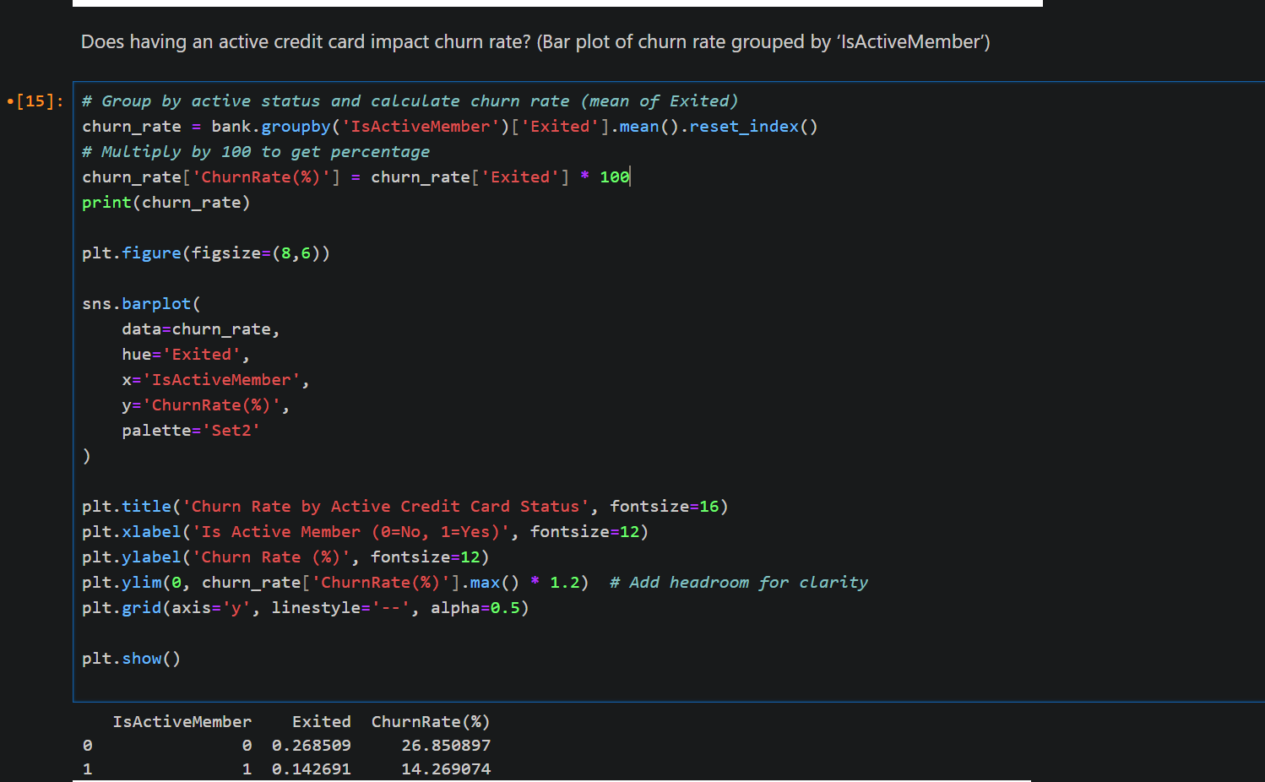

Slide 16
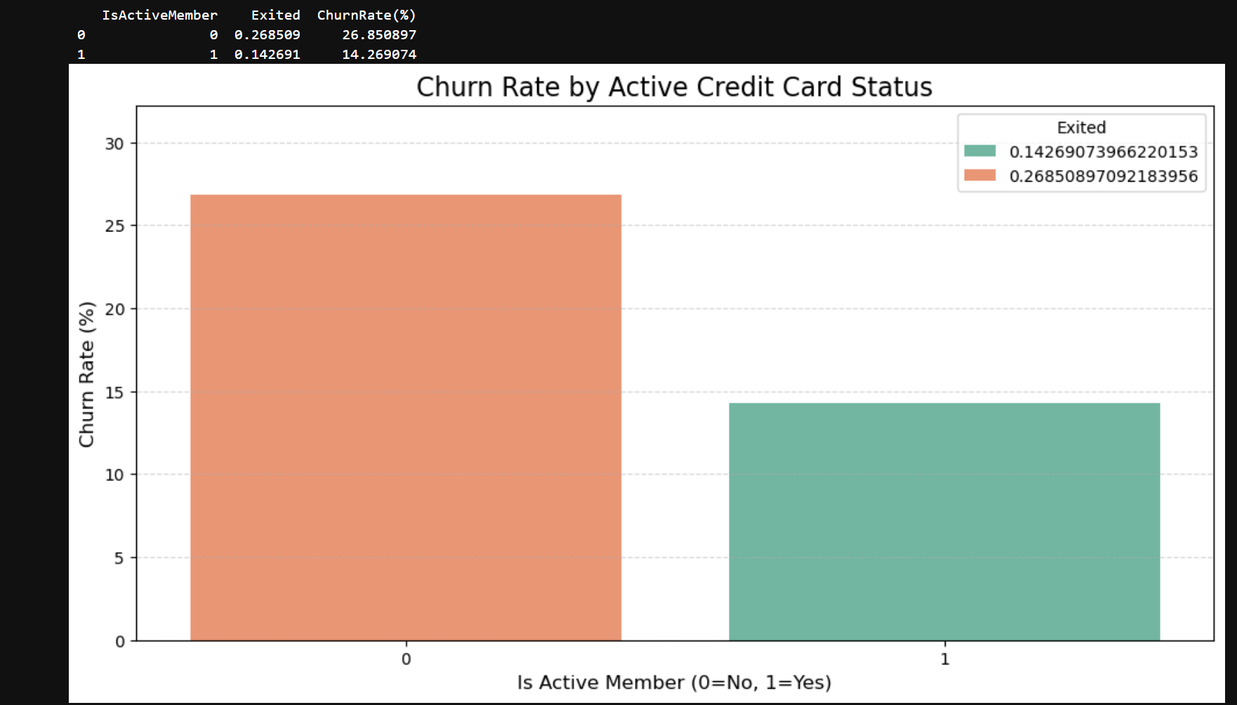

Slide 17
"Data Distribution Using Scatterplot"
Exploring Credit Score Patterns Across Key Bank Features
In this section, we visualized how a customer's Credit Score is distributed against three important banking attributes: Tenure, Balance, and Estimated Salary. Using scatter plots, we aimed to uncover any potential correlations or unusual data patterns.

Slide 18
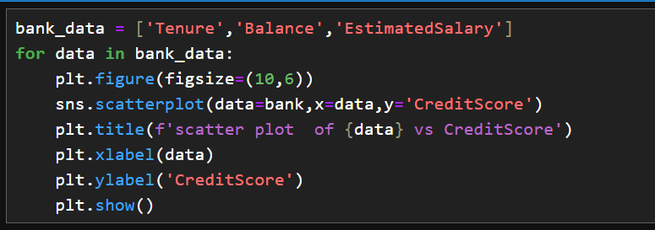
"Data Distribution Using Scatterplot"

Slide 19
Plot 1: Credit Score vs. Tenure
Each vertical column of points corresponds to a specific tenure (ranging from 0 to 10 years).
The uniform spread of credit scores across all tenure values suggests no strong correlation between tenure and credit score.
This implies that simply staying longer with the bank does not guarantee a better credit score.

Slide 20
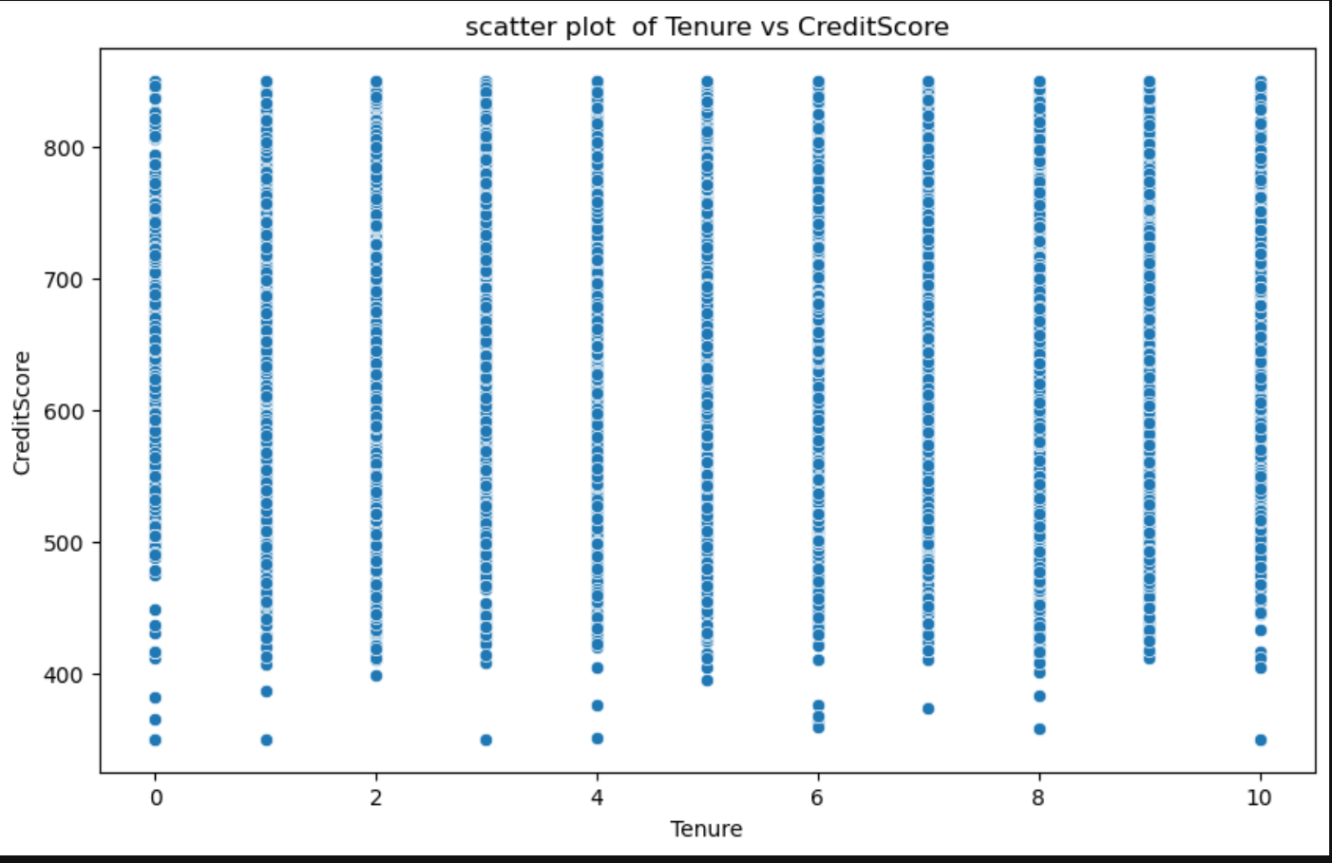

Slide 21
Plot 2: Credit Score vs. Balance
Here, we observe an interesting cluster of customers with zero balance, regardless of their credit scores.
Aside from this, credit scores are densely packed around the middle balance range, forming a circular pattern.
This could indicate a large customer segment with moderate balances and varied credit scores, but again, no strong linear correlation is visible.

Slide 22
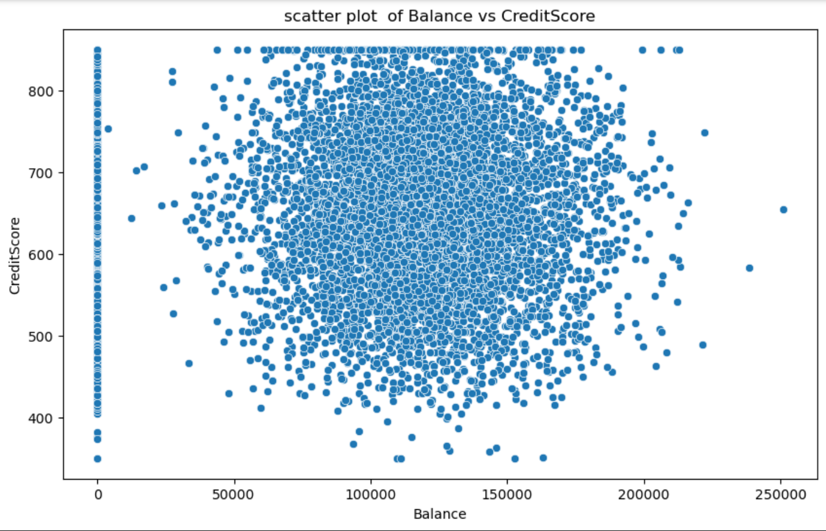

Slide 23
Plot 3 - Credit Score vs. Estimated Salary
This plot displays a uniform distribution of credit scores across all salary ranges.
Whether a customer earns a low or high salary, their credit score varies widely.
This lack of pattern hints that Estimated Salary doesn't play a major role in determining credit scores in this dataset.

Slide 24
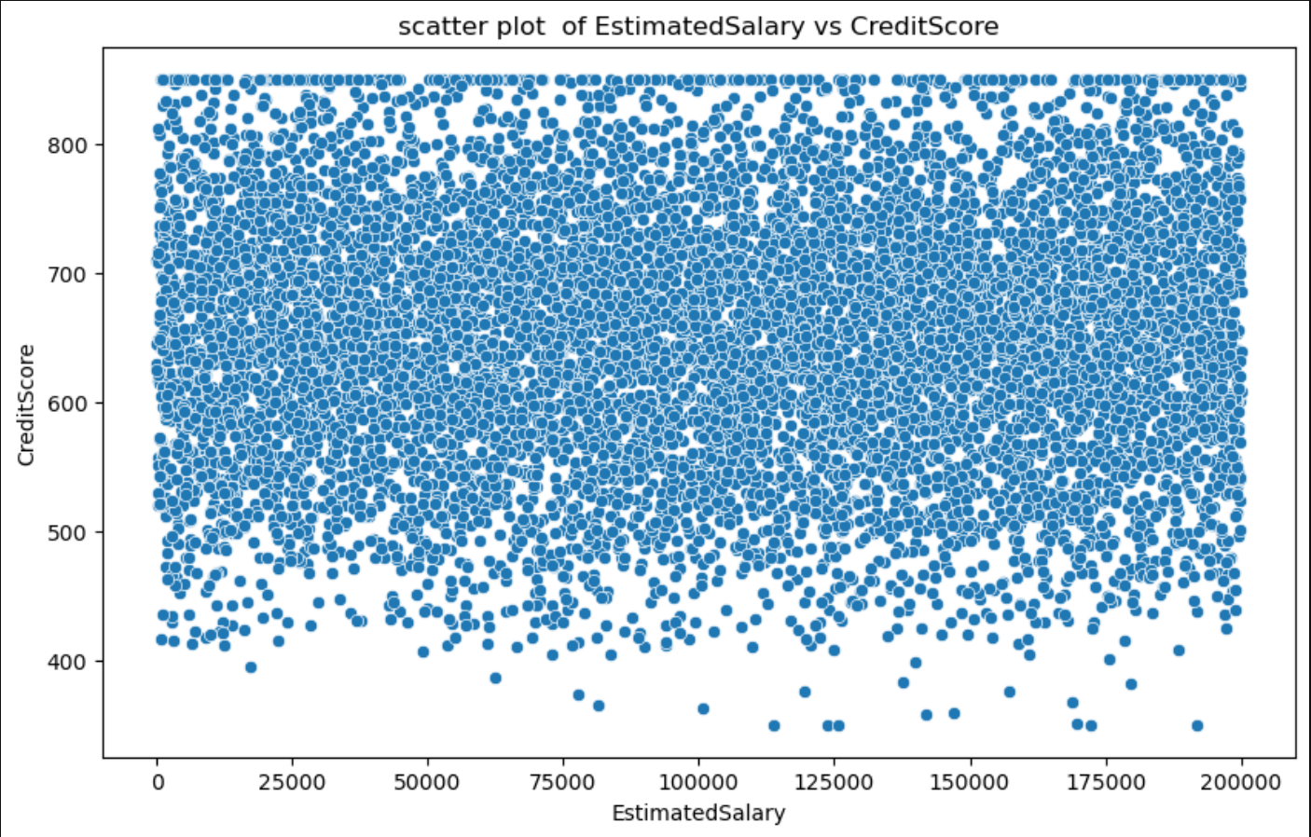

Slide 25
Valuable Insights
1. High Churn Risk Among Older Customers:
Customers who exited the bank are generally older and tend to have higher account balances.
This may indicate dissatisfaction among senior or high-value customers — possibly due to lack of personalized services or benefits.
2. Zero Balance Accounts Are Common:
A significant number of customers maintain a zero balance, even if they have a decent credit score.
This could indicate inactive accounts or customers using the bank for services other than deposits (e.g., loans, cards).
3. Credit Score is Widely Distributed:
Credit Score does not show strong correlation with:
Tenure (how long the customer has been with the bank)
Balance
Estimated Salary
This suggests that credit scores are likely influenced by other factors like repayment behavior, credit usage, or external credit history.

Slide 26
4. No Strong Link Between Salary and Churn or Credit Score:
Estimated salary is uniformly spread across the credit score and does not seem to influence churn behavior.
Indicates that income alone isn't a major driver for leaving the bank or having better credit.
5. Age Positively Correlates with Balance:
As age increases, the average balance in the account also increases.
This may suggest that older customers are more financially stable or save more over time.
6. Presence of Outliers in Balance and Salary:
The dataset contains extreme outliers, especially in balance.
These may skew statistical results and should be treated in any predictive modeling for better accuracy.

Slide 27
Business Takeaway:
Investigate why so many customers hold zero balances — could be a red flag for engagement.
Consider enriching the data with behavioral indicators for better churn and credit score predictions.
Focus on retaining older, high-balance customers with loyalty programs or exclusive services.

Slide 28
BY-PRIYANSHU RAJPUT DA/DS 34
THANKS😎

